Slide 1
How to control your mblock using remote ?

Slide 2
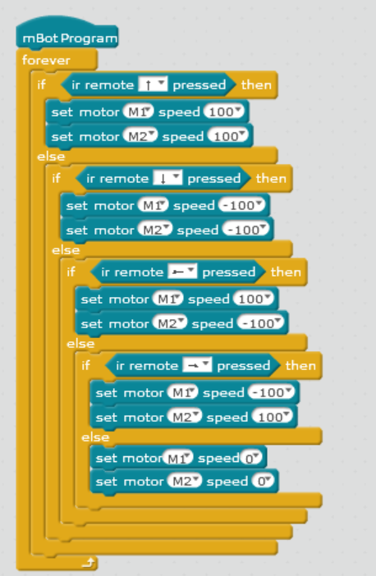
STEP 1: Write the code
Start your mBlock application in your computer
Using the tools from the Events, Controls and Robot section, write the following code
Your program should look like this !

Slide 3
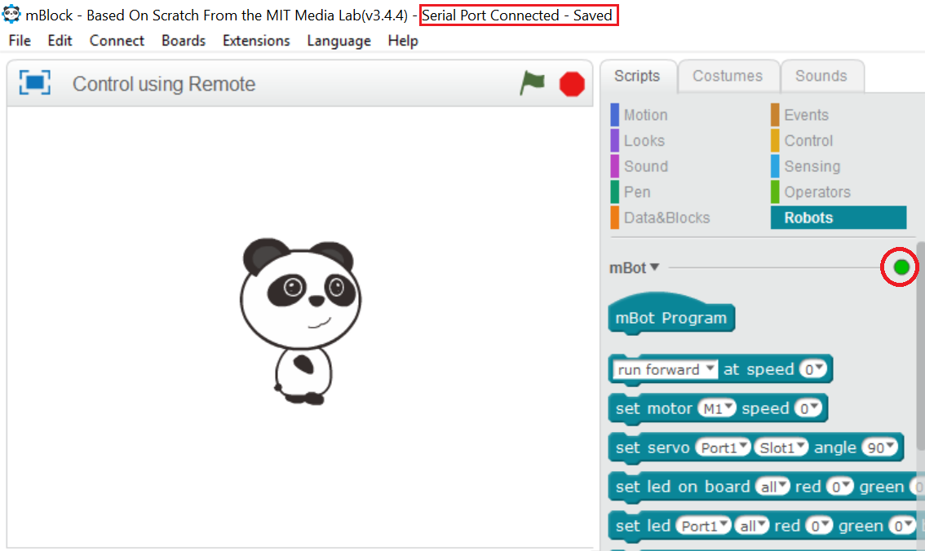
STEP 2: Connect the mBlock
Now that our program has been completed, go to ahead and upload it in mBlock.
To do that, connect your mBlock to your computer using the USB cable.
Select Connect > Serial Port > COM3
your mBlock application’s taskbar should look like this.

Slide 4
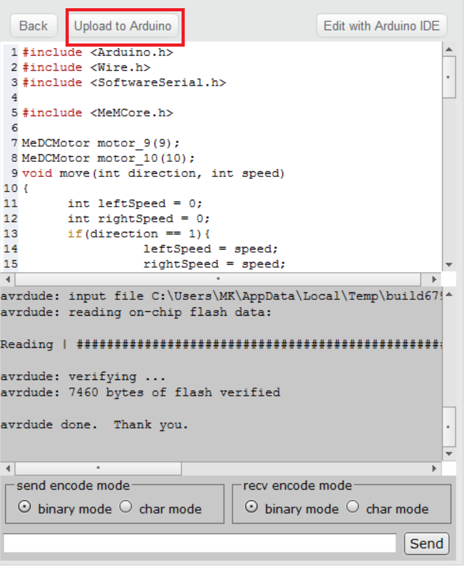
STEP 3: Upload the program
Press anywhere on the program, a new screen will open from the right side of the application
Now, press Upload to Arduino
When the uploading is done, press finish
Disconnect the USB cable and start to play with your remote !!

